Slide 1

Chapter 8 – Designing Classes

Slide 2

Chapter Goals
To learn how to choose appropriate classes for a given problem
To understand the concept of cohesion
To minimize dependencies and side effects
To learn how to find a data representation for a class
To understand static methods and variables
To learn about packages
To learn about unit testing frameworks

Slide 3
Discovering Classes
A class represents a single concept from the problem domain. Name for a class should be a noun that describes concept.
Concepts from mathematics:
Point Rectangle Ellipse
Concepts from real life:
BankAccount CashRegister

Slide 4
Discovering Classes
Actors (end in -er, -or) — objects do some kinds of work for you:
Scanner
Random // Better name: RandomNumberGenerator
Utility classes — no objects, only static methods and constants:
Math
Program starters: a class with only a main method
The class name should indicate what objects of the class will do: Paycheck is a better name than PaycheckProgram.
Don't turn a single operation action into a class: Paycheck is a better name than ComputePaycheck.

Slide 5
Self Check 8.1
What is the rule of thumb for finding classes?
Answer: Look for nouns in the problem description.

Slide 6
Self Check 8.2
Your job is to write a program that plays chess. Might ChessBoard be an appropriate class? How about MovePiece?
Answer: Yes (ChessBoard) and no (MovePiece).

Slide 7

Designing Good Methods - Cohesion
A class should represent a single concept.
The public interface of a class is cohesive if all of its features are related to the concept that the class represents.
The members of a cohesive team have a common goal.

Slide 8
Designing Good Methods - Cohesion
This class lacks cohesion.
public class CashRegister
{
public static final double QUARTER_VALUE = 0.25; public static final double DIME_VALUE = 0.1; public static final double NICKEL_VALUE = 0.05;
. . .
public void receivePayment(int dollars, int quarters, int dimes, int nickels, int pennies)
. . .
}
It contains two concepts
A cash register that holds coins and computes their total The values of individual coins.

Slide 9
Designing Good Methods - Cohesion
Solution: Make two classes:
public class Coin
{
public Coin(double aValue, String aName) { . . . } public double getValue() { . . . }
. . .
}
public class CashRegister
{
. . .
public void receivePayment(int coinCount, Coin coinType)
{
payment = payment + coinCount * coinType.getValue();
}
. . .
}
Now CashRegister class can handle any type of coin.

Slide 10
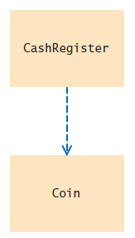
Minimizing Dependencies
A class depends on another class if its methods use that class in any way.
CashRegister depends on Coin
UML: Unified Modeling Language
Notation for object-oriented analysis and design
Figure 1 UML class diagram showing dependency
relationship between the CashRegister and Coin
Classes.
The Coin class does not depend on the CashRegister
class.

Slide 11
Minimizing Dependencies
Example: printing BankAccount balance Recommended
System.out.println("The balance is now $" + momsSavings.getBalance());
Don't add a printBalance method to BankAccount
public void printBalance() // Not recommended
{
System.out.println("The balance is now $" + balance);
}
The method depends on System.out
Not every computing environment has System.out
Violates the rule of minimizing dependencies
Best to decouple input/output from the work of your classes
Place the code for producing output or consuming input in a separate class.

Slide 12
Separating Accessors and Mutators
A mutator method changes the state of an object.
An accessor method asks an object to compute a result, without changing the state.
An immutable class has no mutator methods.
String is an immutable class
No method in the String class can modify the contents of a string.
References to objects of an immutable class can be safely shared.

Slide 13

Separating Accessors and Mutators
In a mutable class, separate accessors and mutators A method that returns a value should not be a mutator.
In general, all mutators of your class should have return type
void.
Sometimes a mutator method can return an informational value.
ArrayList remove method returns true if the removal was successful.
To check the temperature of the water in the bottle, you could take a sip, but that would be the equivalent of a mutator method.

Slide 14
Minimizing Side Effects
A side effect of a method is any externally observable data modification.
Mutator methods have a side effect, namely the modification of the implicit parameter.
In general, a method should not modify its parameter variables.
/**
Computes the total balance of the given accounts.
@param accounts a list of bank accounts
*/
public double getTotalBalance(ArrayList<String> accounts)
{
double sum = 0;
while (studentNames.size() > 0)
{
BankAccount account = accounts.remove(0); // Not recommended sum = sum + account.getBalance();
}
return sum;
}
}
Such a side effect would not be what most programmers expect.

Slide 15

Minimizing Side Effects
The following method mutates the System.out object, which is not a part of the BankAccount object.
public void printBalance() // Not recommended
{
System.out.println("The balance is now $" + balance);
}
That is a side effect.
Keep most of your classes free from input and output operations.
This taxi has an undesirable side effect, spraying bystanders with muddy water.
When designing methods, minimize side effects.

Slide 16
Self Check 8.3
Why is the CashRegister class from Chapter 4 not cohesive?
Answer: Some of its features deal with payments, others with coin values.

Slide 17
Self Check 8.4
Why does the Coin class not depend on the CashRegister class?
Answer: None of the coin operations require the
CashRegister class.

Slide 18
Self Check 8.5
Why is it a good idea to minimize dependencies between classes?
Answer: If a class doesn't depend on another, it is not affected by interface changes in the other class.

Slide 19
Self Check 8.6
Is the substring method of the String class an accessor or a mutator?
Answer: It is an accessor – calling substring doesn't modify the string on which the method is invoked. In fact, all methods of the String class are accessors.

Slide 20
Self Check 8.7
Is the Rectangle class immutable?
Answer: No – translate is a mutator.

Slide 21
Self Check 8.8
If a refers to a bank account, then the call a.deposit(100) modifies the bank account object. Is that a side effect?
Answer: It is a side effect; this kind of side effect is common in object-oriented programming.

Slide 22
Self Check 8.9
Consider the Student class of Chapter 7. Suppose we add a method
void read(Scanner in)
{
while (in.hasNextDouble()) addScore(in.nextDouble());
}
Does this method have a side effect other than mutating the data set?
Answer: Yes – the method affects the state of the Scanner
argument.

Slide 23

Consistency
Use a consistent scheme for method names and parameter variables.
While it is possible to eat with mismatched silverware, consistency is more pleasant.

Slide 24
Problem Solving: Patterns for Object Data - Keeping a Total
All classes that manage a total follow the same basic pattern.
Keep an instance variable that represents the current total:
private double purchase;
Provide these methods as necessary
A method to increase the total by a given amount
public void recordPurchase(double amount)
{
purchase = purchase + amount;
}
A method that reduces or clears the total
public void clear()
{
purchase = 0;
}
A method that yields the current total
public double getAmountDue()
{
return purchase;
}

Slide 25
Problem Solving: Patterns for Object Data - Counting Events
A counter that counts events is incremented in methods that correspond to the events.
Keep a counter:
private int itemCount;
Increment the counter in those methods that correspond to the events that you want to count:
public void recordPurchase(double amount)
{
purchase = purchase + amount; itemCount++;
}
Provide a method to clear the counter if necessary:
public void clear()
{
purchase = 0;
itemCount = 0;
}
You may need a method to report the count to the user of the class.

Slide 26

Problem Solving: Patterns for Object Data - Collecting Values
An object can collect other objects in an array or array list.
A shopping cart object needs to manage a collection of items.
An array list is usually easier to use than an array:
public class Question
{
private ArrayList<String> choices;
. . .
}

Slide 27
Problem Solving: Patterns for Object Data - Collecting Values
Initialize the instance variable to an empty collection:
public Question()
{
choices = new ArrayList<String>();
}
Supply a mechanism for adding values:
public void add(String option)
{
choices.add(option);
}
The user of a Question object can call this method multiple times to add the choices.

Slide 28
Problem Solving: Patterns for Object Data - Managing Properties of an Object
A property is a value of an object that an object user can set and retrieve.
Provide an instance variable to store the property’s value and methods to get and set it.
public class Student
{
private String name;
. . .
public String getName() { return name; }
public void setName(String newName) { name = newName; }
...
}
It is common to add error checking to the setter method:
public void setName(String newName)
{
if (newName.length() > 0) { name = newName; }
}
Some properties should not change after they have been set

Slide 29
Some properties should not change after they have been set in the constructor
Don’t supply a setter method
public class Student
{
private int id;
. . .
public Student(int anId) { id = anId; } public String getId() { return id; }
// No setId method
. . .
}

Slide 30

Problem Solving: Patterns for Object Data - Modeling Objects with Distinct States
Some objects have behavior that varies depending on what has happened in the past.
If a fish is in a hungry state, its behavior changes.
Supply an instance variable for the current state:
public class Fish
{
private int hungry;
. . .
}

Slide 31
Supply constants for the state values:
public static final int NOT_HUNGRY = 0; public static final int SOMEWHAT_HUNGRY = 1; public static final int VERY_HUNGRY = 2;

Slide 32
Problem Solving: Patterns for Object Data - Modeling Objects with Distinct States
Determine which methods change the state:
public void eat()
{
hungry = NOT_HUNGRY;
. . .
}
public void move()
{
. . .
if (hungry < VERY_HUNGRY) { hungry++; }
}
Determine where the state affects behavior:
public void move()
{
if (hungry == VERY_HUNGRY)
{
Look for food.
}
. . .
}

Slide 33
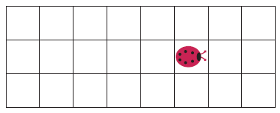
Problem Solving: Patterns for Object Data - Describing the Position of an Object
To model a moving object:
You need to store and update its position.
You may also need to store its orientation or velocity.
If the object moves along a line, you can represent the position as a distance from a fixed point:
private double distanceFromTerminus;
If the object moves in a grid, remember its current location and direction in the grid:
private int row; private int column;
private int direction; // 0 = North, 1 = East, 2 = South, 3 = West
A bug in a grid needs to store its row, column, and direction.

Slide 34
Problem Solving: Patterns for Object Data - Describing the Position of an Object
There will be methods that update the position. You may be told how much the object moves:
public void move(double distanceMoved)
{
distanceFromTerminus = distanceFromTerminus + distanceMoved;
}
If the movement happens in a grid, you need to update the row or column, depending on the current orientation.
public void moveOneUnit()
{
if (direction == NORTH) { row--; }
else if (direction == EAST) { column++; } else if (direction == SOUTH) { row++; } else if (direction == WEST) { column––; }
}
Your program will simulate the actual movement in some way. Locate the methods that move the object, and update the positions according to the rules of the simulation.

Slide 35
Self Check 8.10
Suppose we want to count the number of transactions in a bank account in a statement period, and we add a counter to the BankAccount class:
public class BankAccount
{
private int transactionCount;
...
}
In which methods does this counter need to be updated?
Answer: It needs to be incremented in the deposit and withdraw methods. There also needs to be some method to reset it after the end of a statement period.

Slide 36
Self Check 8.11
In How To 3.1, the CashRegister class does not have a getTotalPurchase method. Instead, you have to call receivePayment and then giveChange. Which recommendation of Section 8.2.4 does this design violate? What is a better alternative?
Answer: The giveChange method is a mutator that returns a value that cannot be determined any other way. Here is a better design. The receivePayment method could decrease the purchase instance variable. Then the program user would call receivePayment, determine the change by calling getAmountDue, and call the clear method to reset the cash register for the next sale.

Slide 37
Self Check 8.12
In the example in Section 8.3.3, why is the add method required? That is, why can’t the user of a Question object just call the add method of the ArrayList<String> class?
Answer: The ArrayList<String> instance variable is private, and the class users cannot acccess it.

Slide 38
Self Check 8.13
Suppose we want to enhance the CashRegister class in How To 3.1 to track the prices of all purchased items for printing a receipt. Which instance variable should you provide? Which methods should you modify?
Answer: You need to supply an instance variable that can hold the prices for all purchased items. This could be an ArrayList<Double> or ArrayList<String>, or it could simply be a String to which you append lines. The instance variable needs to be updated in the recordPurchase method. You also need a method that returns the receipt.

Slide 39
Self Check 8.14
Consider an Employee class with properties for tax ID number and salary. Which of these properties should have only a getter method, and which should have getter and setter methods?
Answer: The tax ID of an employee does not change, and no setter method should be supplied. The salary of an employee can change, and both getter and setter methods should be supplied.

Slide 40
Self Check 8.15
Suppose the setName method in Section 8.3.4 is changed so that it returns true if the new name is set, false if not. Is this a good idea?
Answer: Section 8.2.3 suggests that a setter should return void, or perhaps a convenience value that the user can also determine in some other way. In this situation, the caller could check whether newName is blank, so the change is fine.

Slide 41
Self Check 8.16
Look at the direction instance variable in the bug example in Section 8.3.6. This is an example of which pattern?
Answer: It is an example of the “state pattern” described in Section 8.3.5. The direction is a state that changes when the bug turns, and it affects how the bug moves.

Slide 42
Static Variables and Methods - Variables
A static variable belongs to the class, not to any object of the class.
To assign bank account numbers sequentially
Have a single value of lastAssignedNumber that is a property of the class, not any object of the class.
Declare it using the static reserved word
public class BankAccount
{
private double balance; private int accountNumber;
private static int lastAssignedNumber = 1000;
public BankAccount()
{
lastAssignedNumber++;
accountNumber = lastAssignedNumber;
}
. . .
}

Slide 43
Static Variables and Methods
Every BankAccount object has its own balance and
accountNumber instance variables
All objects share a single copy of the lastAssignedNumber
variable
That variable is stored in a separate location, outside any BankAccount objects
Static variables should always be declared as private,
This ensures that methods of other classes do not change their values
static constants may be either private or public
public class BankAccount
{
public static final double OVERDRAFT_FEE = 29.95;
. . .
}
Methods from any class can refer to the constant as
BankAccount.OVERDRAFT_FEE.

Slide 44
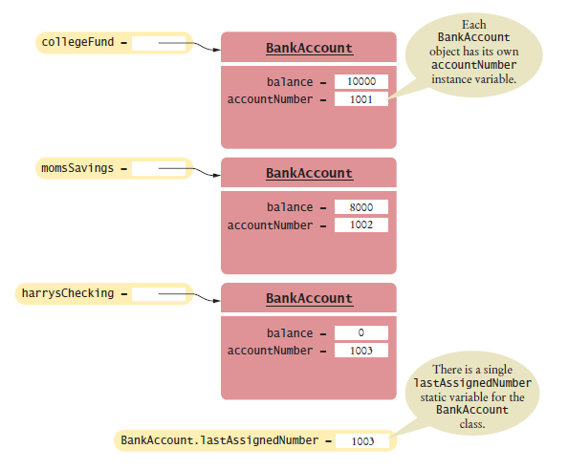
Static Variables and Methods
Figure 5 A Static Variable and Instance Variables

Slide 45
Static Variables and Methods - Methods
Sometimes a class defines methods that are not invoked on an object
Called a static method
Example: sqrt method of Math class
if x is a number, then the call x.sqrt() is not legal
Math class provides a static method: invoked as Math.sqrt(x)
No object of the Math class is constructed.
The Math qualifier simply tells the compiler where to find the sqrt
method.

Slide 46
Static Variables and Methods
You can define your own static methods:
public class Financial
{
/**
Computes a percentage of an amount.
@param percentage the percentage to apply
@param amount the amount to which the percentage is applied
@return the requested percentage of the amount
*/
public static double percentOf(double percentage, double amount)
{
return (percentage / 100) * amount;
}
}
When calling such a method, supply the name of the class containing it:
double tax = Financial.percentOf(taxRate, total);
The main method is always static.
When the program starts, there aren’t any objects.
Therefore, the first method of a program must be a static method.
Programming Tip: Minimize the Use of Static Methods

Slide 47
Self Check 8.17
Name two static variables of the System class.
Answer: System.in and System.out.

Slide 48
Self Check 8.18
Name a static constant of the Math class
Answer: Math.PI

Slide 49
Self Check 8.19
The following method computes the average of an array of numbers:
public static double average(double[] values)
Why should it not be defined as an instance method?
Answer: The method needs no data of any object. The only required input is the values argument.

Slide 50
Self Check 8.20
Harry tells you that he has found a great way to avoid those pesky objects: Put all code into a single class and declare all methods and variables static. Then main can call the other static methods, and all of them can access the static variables.
Will Harry's plan work? Is it a good idea?
Answer: Yes, it works. Static methods can access static variables of the same class. But it is a terrible idea. As your programming tasks get more complex, you will want to use objects and classes to organize your programs.

Slide 51

Problem Solving: Solve a Simpler Problem First
Simplify the problem
Solve the simpler problem first
Learn from solving the simpler problem
Ease the process of solving the larger problem Arrange picture
Align along top edge
Separate with small gaps
When row is full, start new row

Slide 52
Problem Solving: Solve a Simpler Problem First
Picture class constructor:
public Picture(String filename)
Methods:
public void move(int dx, int dy) public Rectangle getBounds()

Slide 53

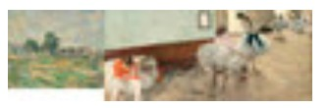
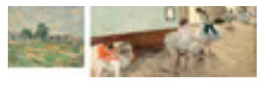
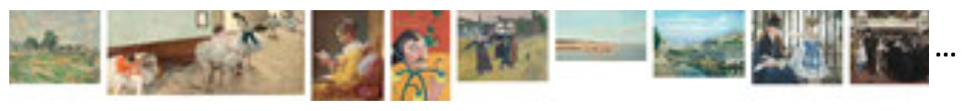
Problem Solving: Solve a Simpler Problem First
Solve series of simpler problems Draw one picture.
Draw two pictures next to each other.
Draw two pictures with a gap between them.
Draw all pictures in a long row.
Draw a row of pictures until you run out of room, then put one

Slide 54

Draw a row of pictures until you run out of room, then put one more picture in the next row.
National Gallery of Art (see page C-1)

Slide 55
Problem Solving: Solve a Simpler Problem First
Become familiar with Picture class
Pictures in files picture1.jpg ... picture20.jpg
public class Gallery1
{
public static void main(String[] args)
{
Picture pic = new Picture("picture1.jpg");
}
}
National Gallery of Art (see page C-1)

Slide 56
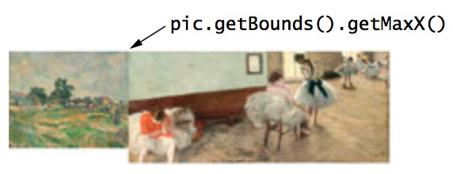
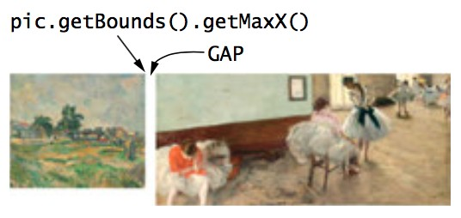
Problem Solving: Solve a Simpler Problem First
Next picture - move to right-most x-coordinate of preceeding picture:
Picture pic = new Picture("picture1.jpg"); Picture pic2 = new Picture("picture2.jpg"); pic2.move(pic.getBounds().getMaxX(), 0);
Separate the two pictures by a small gap:
National Gallery of Art (see page C-1)

Slide 57
final int GAP = 10;
Picture pic = new Picture("picture1.jpg"); Picture pic2 = new Picture("picture2.jpg"); double x = pic.getBounds().getMaxX() + GAP; pic2.move(x, 0);

Slide 58
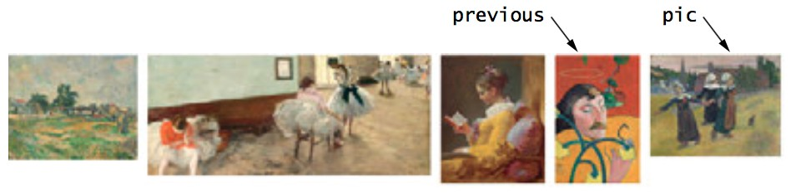
Problem Solving: Solve a Simpler Problem First
Read the pictures in a loop
National Gallery of Art (see page C-1)
final int GAP = 10; final int PICTURES = 20;
Picture pic = new Picture("picture1.jpg"); for (int i = 2; i <= PICTURES; i++)
{
Picture previous = pic;
pic = new Picture("picture" + i + ".jpg"); double x = previous.getBounds().getMaxX() + GAP; pic.move(x, 0);
}

Slide 59
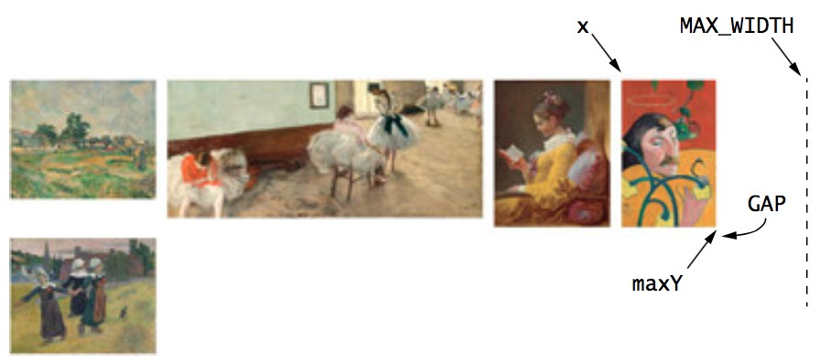
Problem Solving: Solve a Simpler Problem First
Start a new row when pictures extend past right margin:
National Gallery of Art (see page C-1)
double x = previous.getBounds().getMaxX() + GAP; if (x + pic.getBounds().getWidth() < MAX_WIDTH)
{
Place pic on current row.
}
else
{
Place pic on next row.
}
When adding a picture to the current row, update maximum y-

Slide 60
When adding a picture to the current row, update maximum y- coordinate:
maxY = Math.max(maxY, pic.getBounds().getMaxY());
To place a picture on the next row, use the remembered maximum y-coordinate:
pic.move(0, maxY + GAP);

Slide 61
section_5/Gallery6.java
1 public class Gallery6
2 {
3 public static void main(String[] args)
4 {
5
6
7
8
9
10
11
12
13
14
15
16
17
18
19
20
21
22
23
24
25
26
27
28 }
final int final int final int
MAX_WIDTH = 720;
GAP = 10;
PICTURES = 20;
Picture pic = new Picture("picture1.jpg"); double maxY = 0;
for (int i = 2; i < 20; i++)
{
maxY = Math.max(maxY, pic.getBounds().getMaxY()); Picture previous = pic;
pic = new Picture("picture" + i + ".jpg"); double x = previous.getBounds().getMaxX() + GAP; if (x + pic.getBounds().getWidth() < MAX_WIDTH)
{
pic.move(x, previous.getBounds().getY());
}
else
{
pic.move(0, maxY + GAP);
}
}
}

Slide 62
Self Check 8.21
Suppose you are asked to find all words in which no letter is repeated from a list of words. What simpler problem could you try first?
Answer: Of course, there is more than one way to simplify the problem. One way is to print the words in which the first letter is not repeated.

Slide 63
Self Check 8.22
You need to write a program for DNA analysis that checks whether a substring of one string is contained in another string. What simpler problem can you solve first?
Answer: You could first write a program that prints all substrings of a given string.

Slide 64
Self Check 8.23
You want to remove “red eyes” from images and are looking for red circles. What simpler problem can you start with?
Answer: You can look for a single red pixel, or a block of nine neighboring red pixels.

Slide 65
Self Check 8.24
Consider the task of finding numbers in a string. For example, the string “In 1987, a typical personal computer cost $3,000 and had 512 kilobytes of RAM.” has three numbers. Break this task down into a sequence of simpler tasks.
Answer: Here is one plan:
Find the position of the first digit in a string.
Find the position of the first non-digit after a given position in a string.
Extract the first integer from a string (using the preceding two steps).
Print all integers from a string. (Use the first three steps, then repeat with the substring that starts after the extracted integer.)

Slide 66
Packages
Package: Set of related classes Important packages in the Java library:
Package java.lang | Purpose Language support | Sample Class Math
java.util | Utilities | Random
java.io | Input and output | PrintStream
Abstract Windowing Toolkit Applets
Networking Database Access Swing user interface Document Object Model for XML documents
java.awt
Color
java.applet java.net java.sql javax.swing
Applet Socket ResultSet JButton
omg.w3c.dom
Document

Slide 67

Organizing Related Classes into Packages
In Java, related classes are grouped into packages.

Slide 68
Organizing Related Classes into Packages
To put classes in a package, you must place a line
package packageName;
as the first instruction in the source file containing the classes.
Package name consists of one or more identifiers separated by periods.
To put the Financial class into a package named com.horstmann.bigjava, the Financial.java file must start as follows:
package com.horstmann.bigjava; public class Financial
{
. . .
}
A special package: default package
Has no name
No package statement
If you did not include any package statement at the top of your source file
its classes are placed in the default package.

Slide 69
Importing Packages
Can use a class without importing: refer to it by its full name (package name plus class name):
java.util.Scanner in = new java.util.Scanner(System.in);
Inconvenient
import directive lets you refer to a class of a package by its class name, without the package prefix:
import java.util.Scanner;
Now you can refer to the class as Scanner without the package prefix.
Can import all classes in a package:
import java.util.*;
Never need to import java.lang.
You don't need to import other classes in the same package.

Slide 70
Package Names
Use packages to avoid name clashes:
java.util.Timer
vs.
javax.swing.Timer
Package names should be unique.
To get a package name: turn the domain name around:
com.horstmann.bigjava
Or write your email address backwards:
edu.sjsu.cs.walters

Slide 71
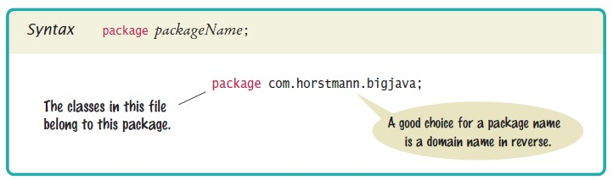
Syntax 8.1 Package Specification

Slide 72
Packages and Source Files
The path of a class file must match its package name.
The parts of the name between periods represent successively nested directories.
Base directory: holds your program's files Place the subdirectory inside the base directory. If your homework assignment is in a directory
/home/britney/hw8/problem1
Place the class files for the com.horstmann. bigjava package into the directory:
/home/britney/hw8/problem1/com/horstmann/bigjava (UNIX)
Or c:\Users\Britney\ hw8\problem1\com\horstmann\ bigjava
(Windows)

Slide 73
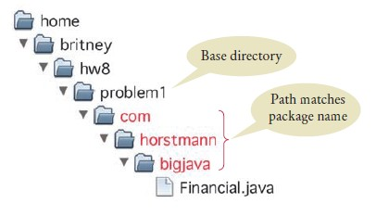
Figure 6 Base Directories and Subdirectories for Packages

Slide 74
Self Check 8.25
Which of the following are packages?
java
java.lang
java.util
java.lang.Math
Answer: (a) No; (b) Yes; (c) Yes; (d) No

Slide 75
Self Check 8.26
Is a Java program without import statements limited to using the default and
java.lang packages?
Answer: No — you simply use fully qualified names for all other classes, such as java.util.Random and java.awt.Rectangle.

Slide 76
Self Check 8.27
Suppose your homework assignments are located in the directory
/home/me/cs101 (c:\Users\me\cs101 on Windows). Your instructor tells you to place your homework into packages. In which directory do you place the class hw1.problem1.TicTacToeTester?
Answer: /home/me/cs101/hw1/problem1 or, on Windows, c:\Users\me\cs101\hw1\problem1

Slide 77
Unit Test Frameworks
Unit test frameworks simplify the task of writing classes that contain many test cases.
JUnit: http://junit.org
Built into some IDEs like BlueJ and Eclipse
Philosophy: whenever you implement a class, also make a companion test class. Run all tests whenever you change your code.

Slide 78
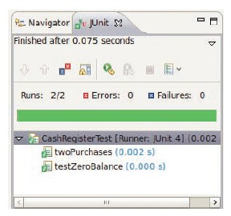
Unit Test Frameworks
Customary that name of the test class ends in Test:
import org.junit.Test; import org.junit.Assert;
public class CashRegisterTest
{
@Test public void twoPurchases()
{
CashRegister register = new CashRegister(); register.recordPurchase(0.75); register.recordPurchase(1.50); register.enterPayment(2, 0, 5, 0, 0); double expected = 0.25;
Assert.assertEquals(expected, register.giveChange(), EPSILON);
}
// More test cases
. . .
}
If all test cases pass, the JUnit tool shows a green bar:
Figure 7 Unit Testing with JUnit

Slide 79
Self Check 8.28
Provide a JUnit test class with one test case for the Earthquake class in Chapter 5.
Answer: Here is one possible answer.
public class EarthquakeTest
{
@Test public void testLevel4()
{
Earthquake quake = new Earthquake(4); Assert.assertEquals("Felt by many people, no destruction",
quake.getDescription());
}
}

Slide 80
Self Check 8.29
What is the significance of the EPSILON parameter in the assertEquals method?
Answer: It is a tolerance threshold for comparing floating-point numbers. We want the equality test to pass if there is a small roundoff error.

